Slide 1

UE20CS390A – Capstone Project Phase – 1
Project Progress Review #3
Project Title : Voice Interface for PESU using AI
Project ID : PW23_PB_01
Project Guide : Prof. Priya Badrinath
Project Team with SRN : 805_806_826_844

Slide 2
Abstract and Scope
Voice assistants use machine learning and natural language processing to respond to user requests.
The scope of a PESU voice assistant is vast and continues to expand as new use cases and functionalities are developed. The potential for voice assistants is limited.
Easier access to PESU resources
Get the latest information about academics
Detect and respond to owner only
Tap talk and get wherever you wish in PESU academy.
Personal voice assistant for students

Slide 3
Suggestions from Review - 2
Suggestions and remarks given by the panel members.
Fetching from documents: We are going to use OpenCV for extraction of table information from ISA and any PDF into CSV.
Voice training module : Natural Language Processing (NLP) will be used to convert normal language queries into database queries.
Voice Authentication : We are going to use Gaussian Mixture Model-Universal Background Model (GMM-UBM) for voice authentication.
Web Scraping : We are fetching the students' data from the PESU Academy using Selenium Web Drivers.

Slide 4
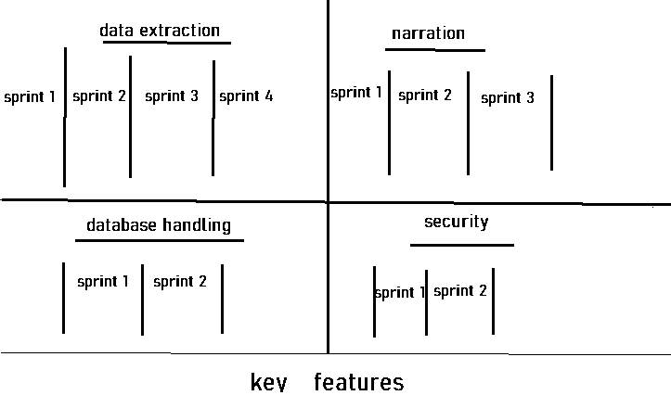
Design Approach
We are following sequential and iterative design models in making of our AI trained voice assistant. (this model will help us in making the software and launch of every sprint in sequential order)
Key features have been divided in four major components

Slide 5
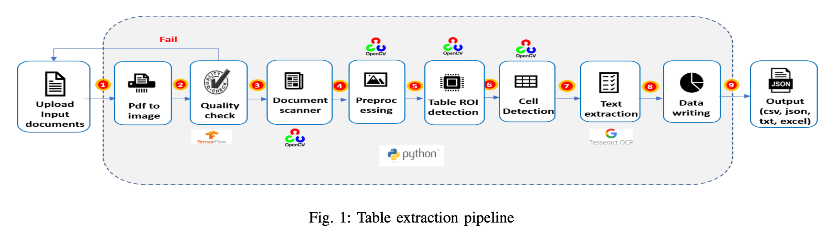
Plan on execution of key features
Data Extraction:
In order to, extract data from image Image has to be in good quality. That’s why we are using Logistic Regression to classify image as good or bad. Accuracy of Logistic Regression model was 83%
For Extraction of data from. We are going to use OpenCV and PY tesseract for text extraction from each cell.

Slide 6
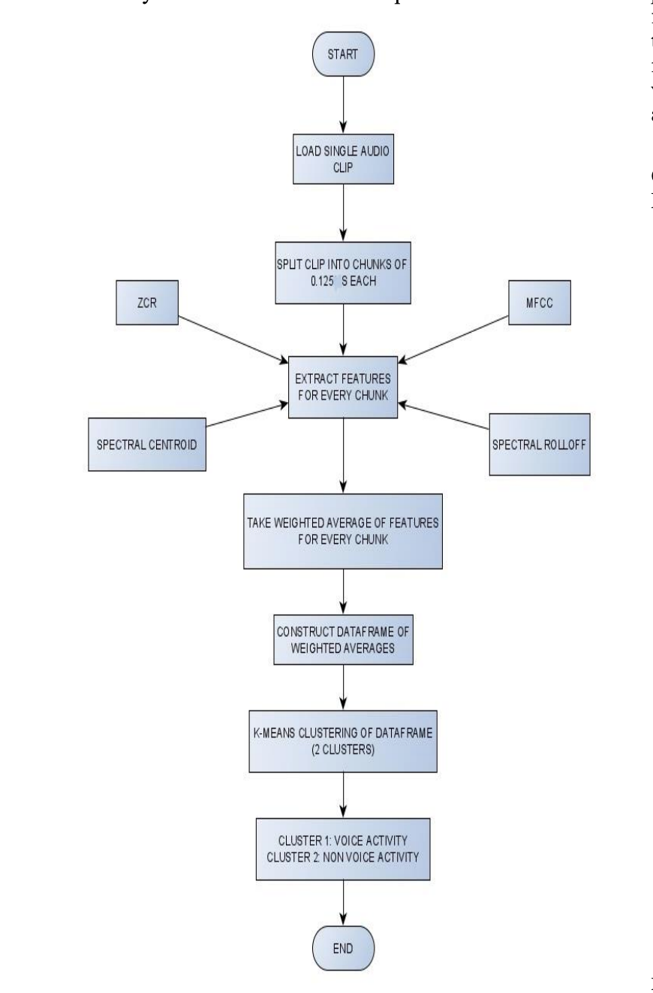
Plan on execution of key features
Working model is simple, audio is broken down into .125 seconds clip, fed to feature extraction algorithm
Then, weights are added and passed to KNN, KNN classifies as human voice and non human voice
Audio Features : -
Mel-Frequency Cepstral Coefficients
Spectral Roll – Off
Spectral Centroid
Zero Crossing Rate

Slide 7
Plan on execution of key features
What do these features tell us
The pitch of the sound: Spectral Centroid and MFCCs can help identify the pitch or fundamental frequency of the sound.
The timbre of the sound: MFCCs can help to identify the timbre or quality of the sound, such as whether it is a voice, a musical instrument or noise.
The rhythmic structure of the sound: Zero Crossing Rate can help to identify the rhythmic structure of the sound, such as how often it repeats.
The overall shape and texture of the sound: Spectral Roll-Off and Spectral Centroid can help identify the overall shape and texture of the sound, such as whether it has a lot of high-pitched or low-pitched frequencies.

Slide 8
Web Scraping
To do web scarping we are using Python libraries that is Selenium Web Driver to extract the students data from the web (PESU Academy)
Selenium is a software tool designed specifically for automating the testing of web applications.
It can also be used as a web scraper to extract data from websites.
For Encryption We are planning to use RSA Encryption Algorithm with SALTING
Fig-Web Scraping using Selenium.

Slide 9
Speech and voice authentication
Natural Language Processing (NLP) will be used to convert normal language queries into database queries by leveraging various techniques such as :
Gaussian mixture models (GMM) : It involves modelling the probability distribution of the spectral features of a person's voice and comparing it to the distribution of known speakers.
Tokenization
Part-of-speech tagging
Named entity recognition
Query generation
Query execution

Slide 10
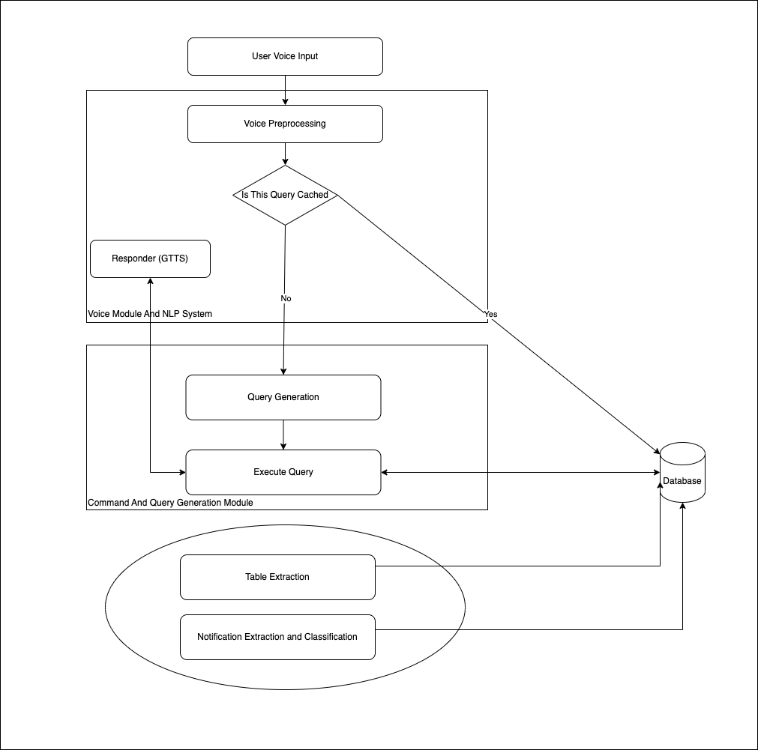
Combining all together

Slide 11
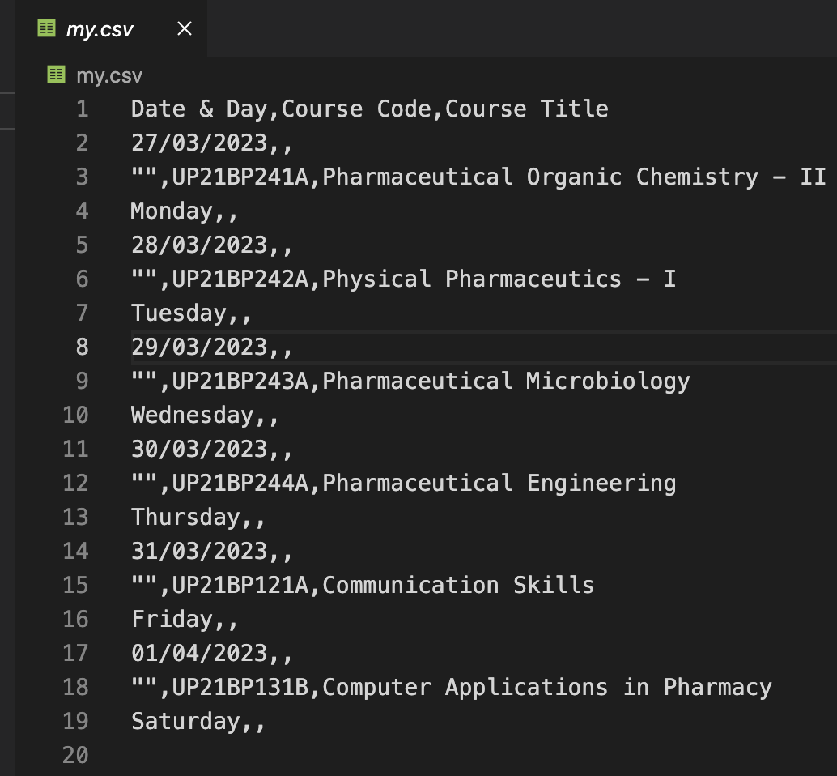
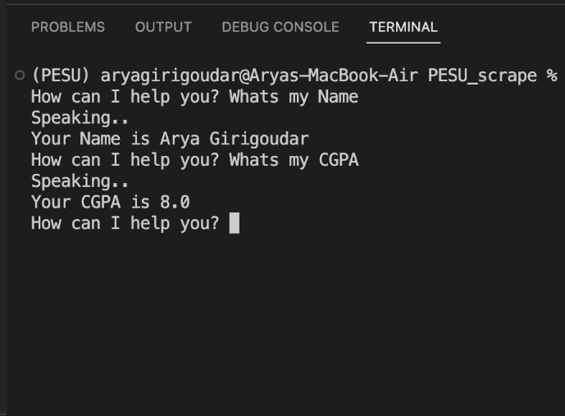
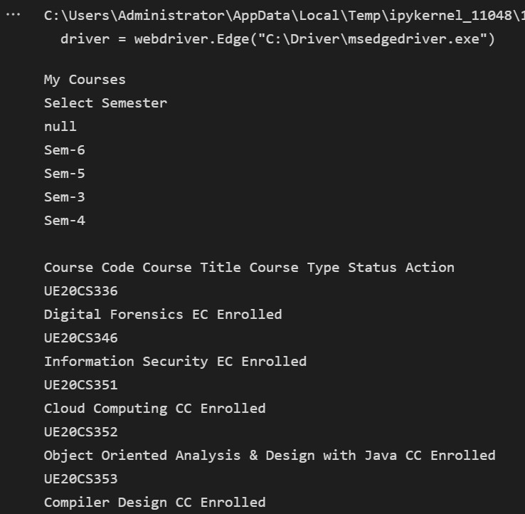
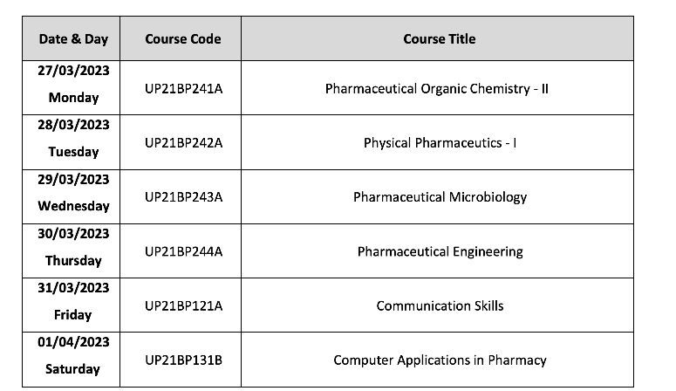
Project Demo

Slide 12
Title of the Project
Project Progress
What is the project progress so far?
We have finalized what to use
We just have to improve our Algorithms to match our Level
What is the percentage completion of the project?
Roughly 40 %

Slide 13
Thank You

